Slide 1
Automated Plant Watering System
The best solution to your laziness.

Slide 2
TOC
Understanding the problems
Project objective
Target audience
Circuit diagram
Sensors and Peripherals
Serial Comms & Cloud
Budget
Project timeline
References

Slide 3
Understanding the problems
01
Traditional irrigation systems are pre-set manually to turn on and off using a timer
02
Studies show that 70% of water consumption around the world is used for irrigation, and half of that is wasted due to inefficient, traditional irrigation practices.
03
A device combining information about plant physiology, real-time soil conditions and weather forecasts can help make more informed decisions about when and how much to irrigate.According to Cornell’s Research his could save 40% of the water consumed by more traditional methods

Slide 4
Project objective
Develop an automated system to monitor soil moisture using soil moisture sensors (connected via GPIO), ambient light using a light sensor (connected via I2C), and control water pumps (using transistors connected via GPIO) to water plants based on their needs. Include a temperature and humidity sensor (connected via I2C) to monitor environmental conditions

Slide 5



Target audience
Professional Landscapers and Garden Maintenance Services
Remote and Vacation Home Owners
Sustainability Advocates

Slide 6
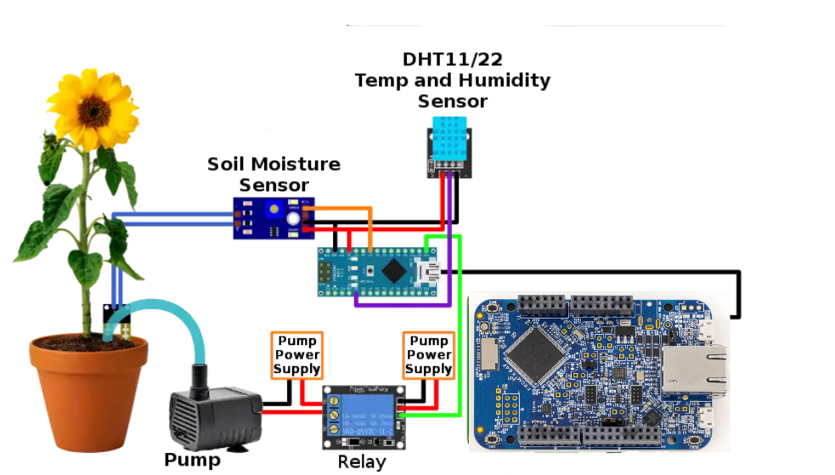
Circuit diagram
Note:This is an abstract C.D
All gnds are common
We will also use an LCD to display current soil moisture levels, temperature, humidity, and last watering time. And a Photoresistor for input to measure the light intensity
Pump power supply is the external 9V battery. And will be controlled by the relay module.
And Relay module will be connected to the microcontroller power supply

Slide 7
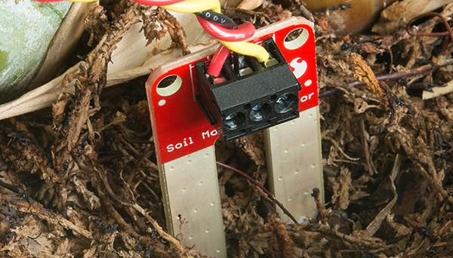
Sensors and Peripherals:
Soil Moisture Sensors: Detect when the soil is dry.
Water Pump(via Relay): Delivers water to the plants.
Temperature and Humidity Sensor (e.g., DHT22): Monitors environmental conditions.
Light Sensor: Measures the light intensity to adjust watering based on plant light exposure.
LCD Display: Shows system status, soil moisture levels, and other relevant data.

Slide 8
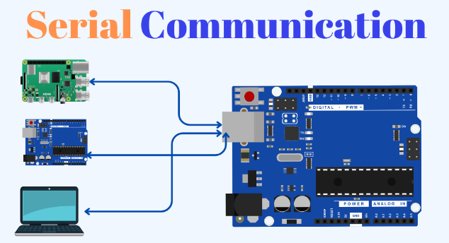
Serial Communication/Cloud Connectivity
We are planning to use serial communication to plot data using matplotlib.This would involve usage of UART’s
We can collect data such as amount of water usage for particular plant,etc.
OR
We are planning to connect K66/64 to the cloud to send data to cloud database.
more scalability,email integration etc.

Slide 9
Budget
Components | Price
LCD | $ 10
DHT22 | $ 10
Water-Pump | $ 11
Soil Moisture Detector | $15
Relay | $ 0 (available)
9v Battery | $ 0 (available)
Photoresistor | $ 2
Total | $ 48

Slide 10
Project timeline
12 Feb - 16 Feb
19 Feb - 23 Feb
26 Feb - 1 March
4 March - 8 March
11 March - 15 March
18 March - 22 March
Requirement Analysis
Hardware Integration
Coding
Serial/Cloud comm
System Testing
Release

Slide 11
Thank you!
Happy Planting!

Slide 12
References
Smart irrigation model predicts rainfall to conserve water | Cornell Chronicle. (2019, July 16). Cornell Chronicle. https://news.cornell.edu/stories/2019/07/smart-irrigation-model-predicts-rainfall-conserve-water
(n.d.). Fritzing. https://fritzing.org/

